Slide 1
Texas Insights Crime/Health/Drugs
Ghirmay WeldeMichael | Manoranjan Kumar | Gary Sepulveda | Sixto San Martin

Slide 2
Design
Introduction & Problem Statement
Data Cleaning & Sources
Analysis & Visualization
Conclusion & Next Steps

Slide 3


Introduction
Destination Texas!
Texas Counties
Crime
Type
Severity
Health
Mortality
Obesity
Drugs
Opioids
Prescriptions

Slide 4
Problem Statement
Texas continues to have significant increases in population growth relative to most other states in the United States, in part due to economic and social factors that lead to a better quality of life, such as lower crime rates.
However, growing social and health trends such as increase in Opioid access and abuse has contributed to changes in Drug related Crimes.
So our project focuses on exploratory data analysis to determine:
What counties have the best profile in terms of Lower Crime, Health and Drugs?
This information can be used to inform new Texas on where to settle in the Lone Star State.

Slide 5
Data Cleaning & Sources
4 main data sources
All data was collected and/or grouped organized by county
Collected data from 1999 – 2015
100+ files
UCR Crime Data was found in CSV files by year
Each year contained the incidents, arrests, agencies, and dozens of lookup tables

Slide 6
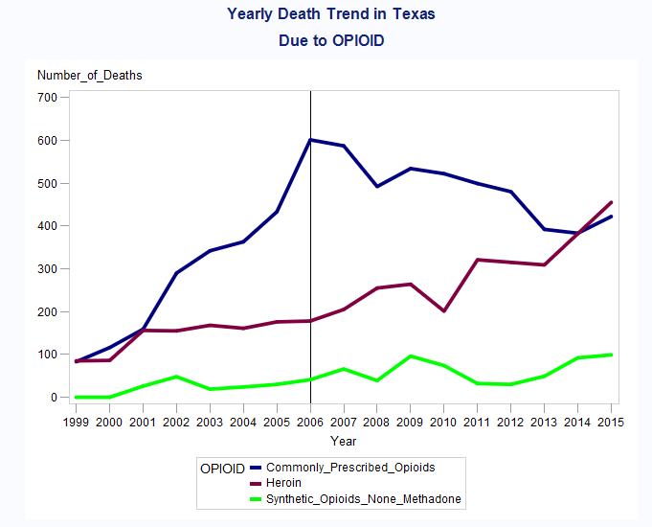
Drugs
Significant decrease of death related to prescribed Opioids
Significant increase in deaths related to Heroin an illicit (illegally made) opioid.
Less pronounced but growing trend in synthetic Opioid deaths.
In some instances, synthetic opioid abuser switch to heroin due to easier access and cost.

Slide 7
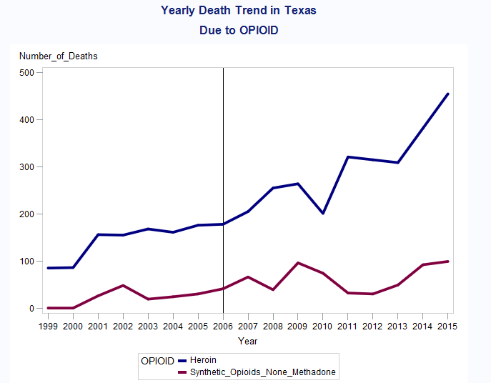
Drugs
Significant increase in deaths related to Heroin an illicit (illegally made) Opioids and trending upwards
Less pronounced but growing trend in synthetic Opioid deaths.
In some instances, synthetic opioid abuser switch to heroin due to easier access and cost.

Slide 8
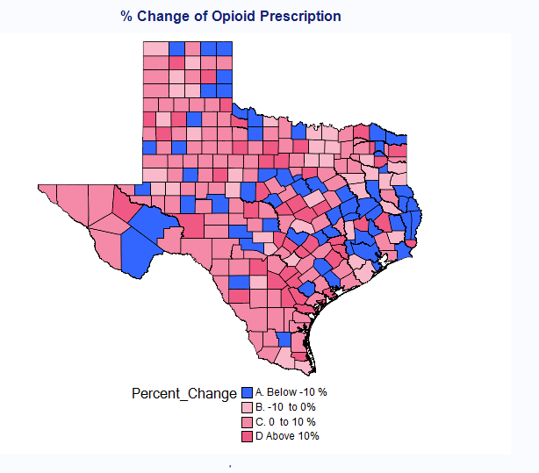
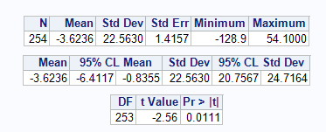
Drugs
Overall prescriptions rates have decreased in Texas.
There appears to be a correlation between lower script and related deaths.
Heroin (illegal and not prescribed) has shown significant increase in death rates.
T test is significant with average change of -3.6

Slide 9
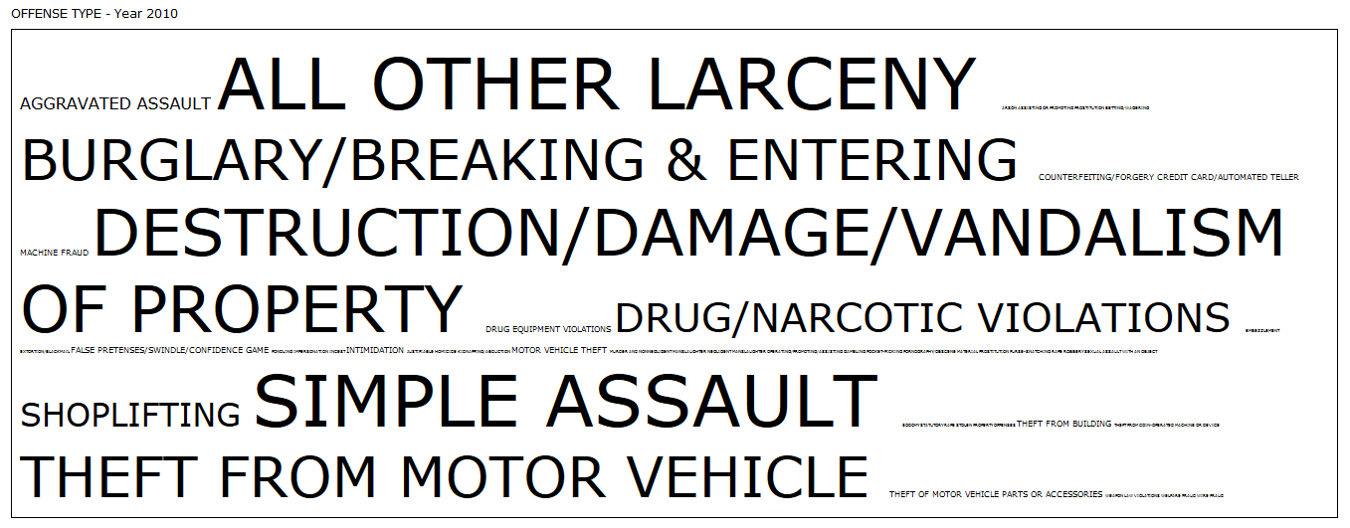
Crime Type - 2010

Slide 10
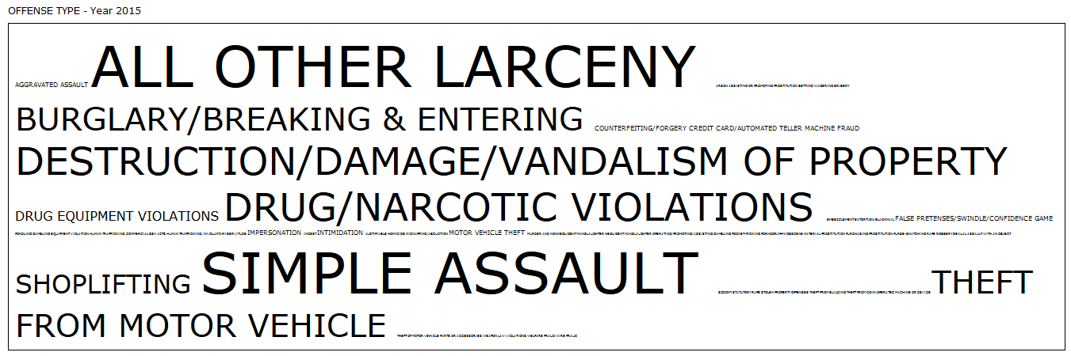
Crime Type - 2015
Significant increase in Drug related Crimes since 2010

Slide 11
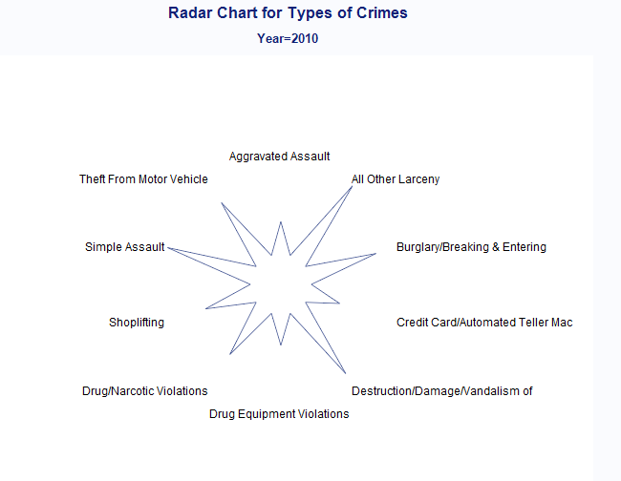
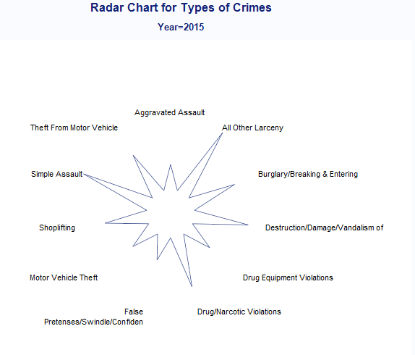
Crime Type
Correlations with HIV etc

Slide 12
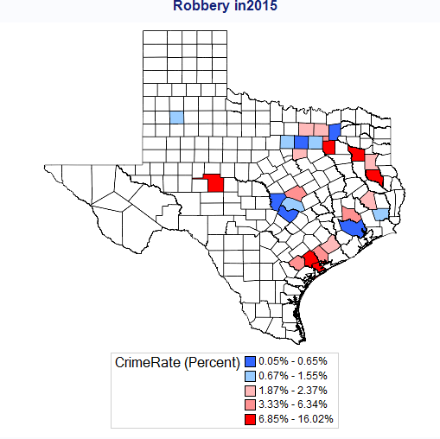
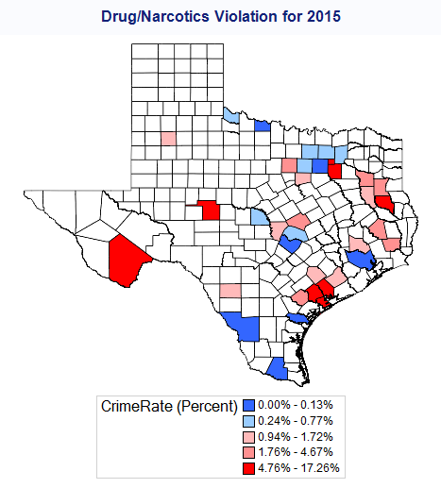
Robber and Drug Crimes/Violations

Slide 13
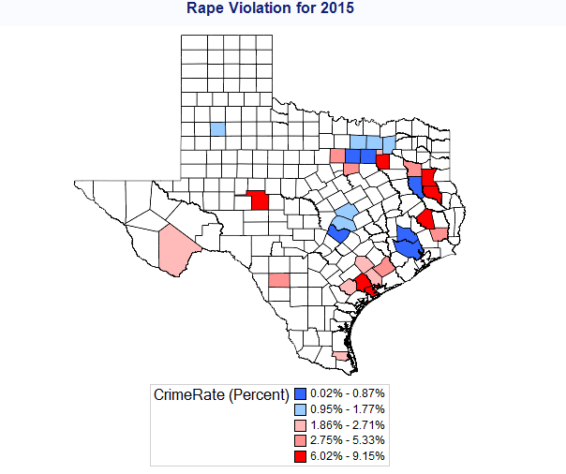

Rape and Drug Crimes/Violations

Slide 14
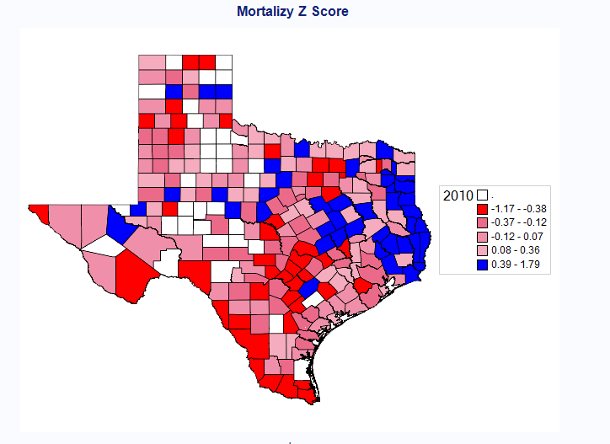
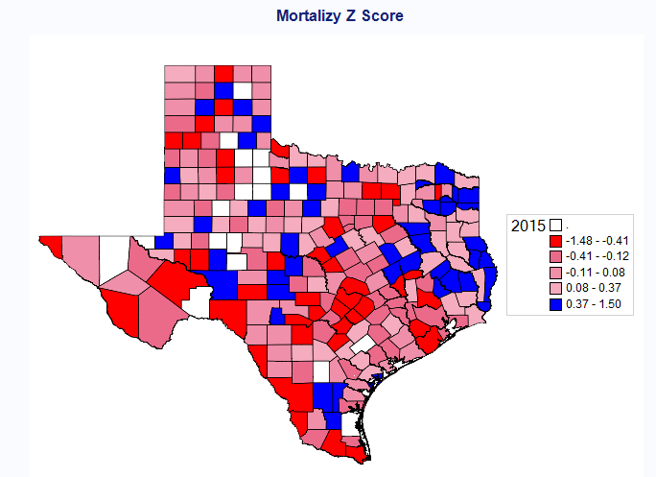
Health :- Mortality

Slide 15
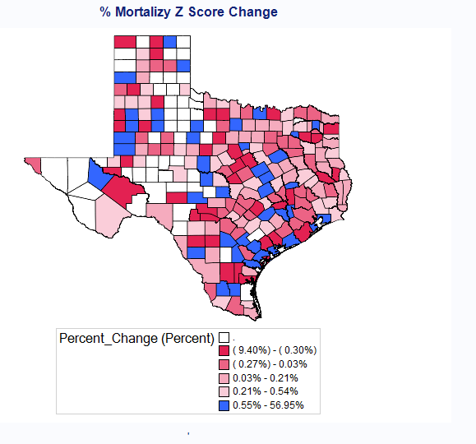
Health
There is a movement of morality
Ranking between counties from
2010 to 2015

Slide 16
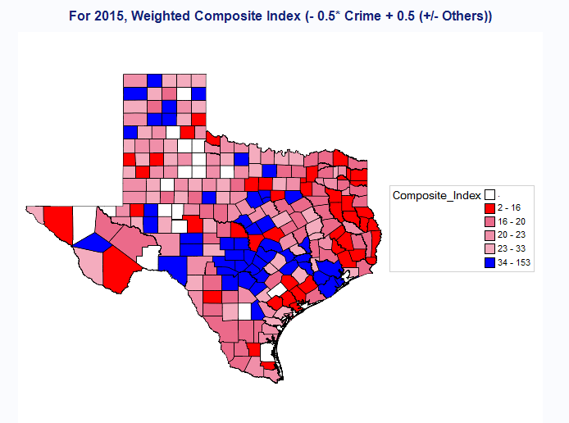
Texas -Composite Score
Composite Score is calculated using weighted (0.5) Crime Rate and 0.5 * Ranks of others :-
Healthy Behaviors
Clinical Care,
Social Economic Factors
Physical Environment
Mortality …etc
The higher Composite score the better Higher Better

Slide 17
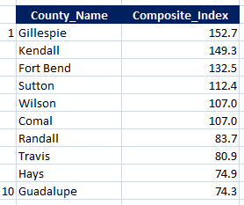
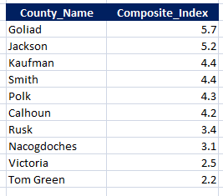
Conclusions
Highest 10
Lowest 10

Slide 18
Next Steps
Enhance data
Add macro economic attributes (Unemployment rate , HPI etc)
Longer history
Modeling
Leverage Modeling to forecast Composite Score
Customize
Ability to customizable weights to calculate Composite Score
App supported

Slide 19
Appendix

Slide 20
Data Sources
Drugs – Uniform Crime Reporting (UCR) Program
Texas Comptroller https://comptroller.texas.gov
Texas DSHS https://dshs.texas.gov
CDC Wonder https://wonder.cdc.gov
Texas Demographic Center https://demographics.texas.gov/

